Slide 1

Spark and Dask
CSCI 8360: Data Science Practicum Lecture 2

Slide 2
Spark and Dask
Two very popular ”big data” tools
Two very different paradigms
Plenty of other ways of scaling your analyses
Parallelization / compilation (numba, PyTorch.jit, JAX, Cython)
Other performant languages (Rust, Julia)
Library-specific optimizations (polars, jax.numpy)
Spark and Dask are closer to “general-purpose” scaling
”user-defined functions” or UDFs
Meant to keep native libraries / tools / languages accessible
Often see immediate performance benefits just from incorporation, but usually requires a good deal of under-the-hood knowledge to eke out every last performance optimization

Slide 3


Apache Spark

Slide 4
Apache Spark
Out of the UC Berkeley AMPLab in 2014
Born out of frustration with the only open source distributed programming paradigm / implementation at the time: Hadoop MapReduce
Too much Hadoop boilerplate
Too many serialization / deserialization operations
Map-reduce paradigm is inflexible (graph analytics? real-time processing? iterative algorithms?)
Focused on bringing data to code
Assumed the absolute worst in terms of hardware reliability

Slide 5
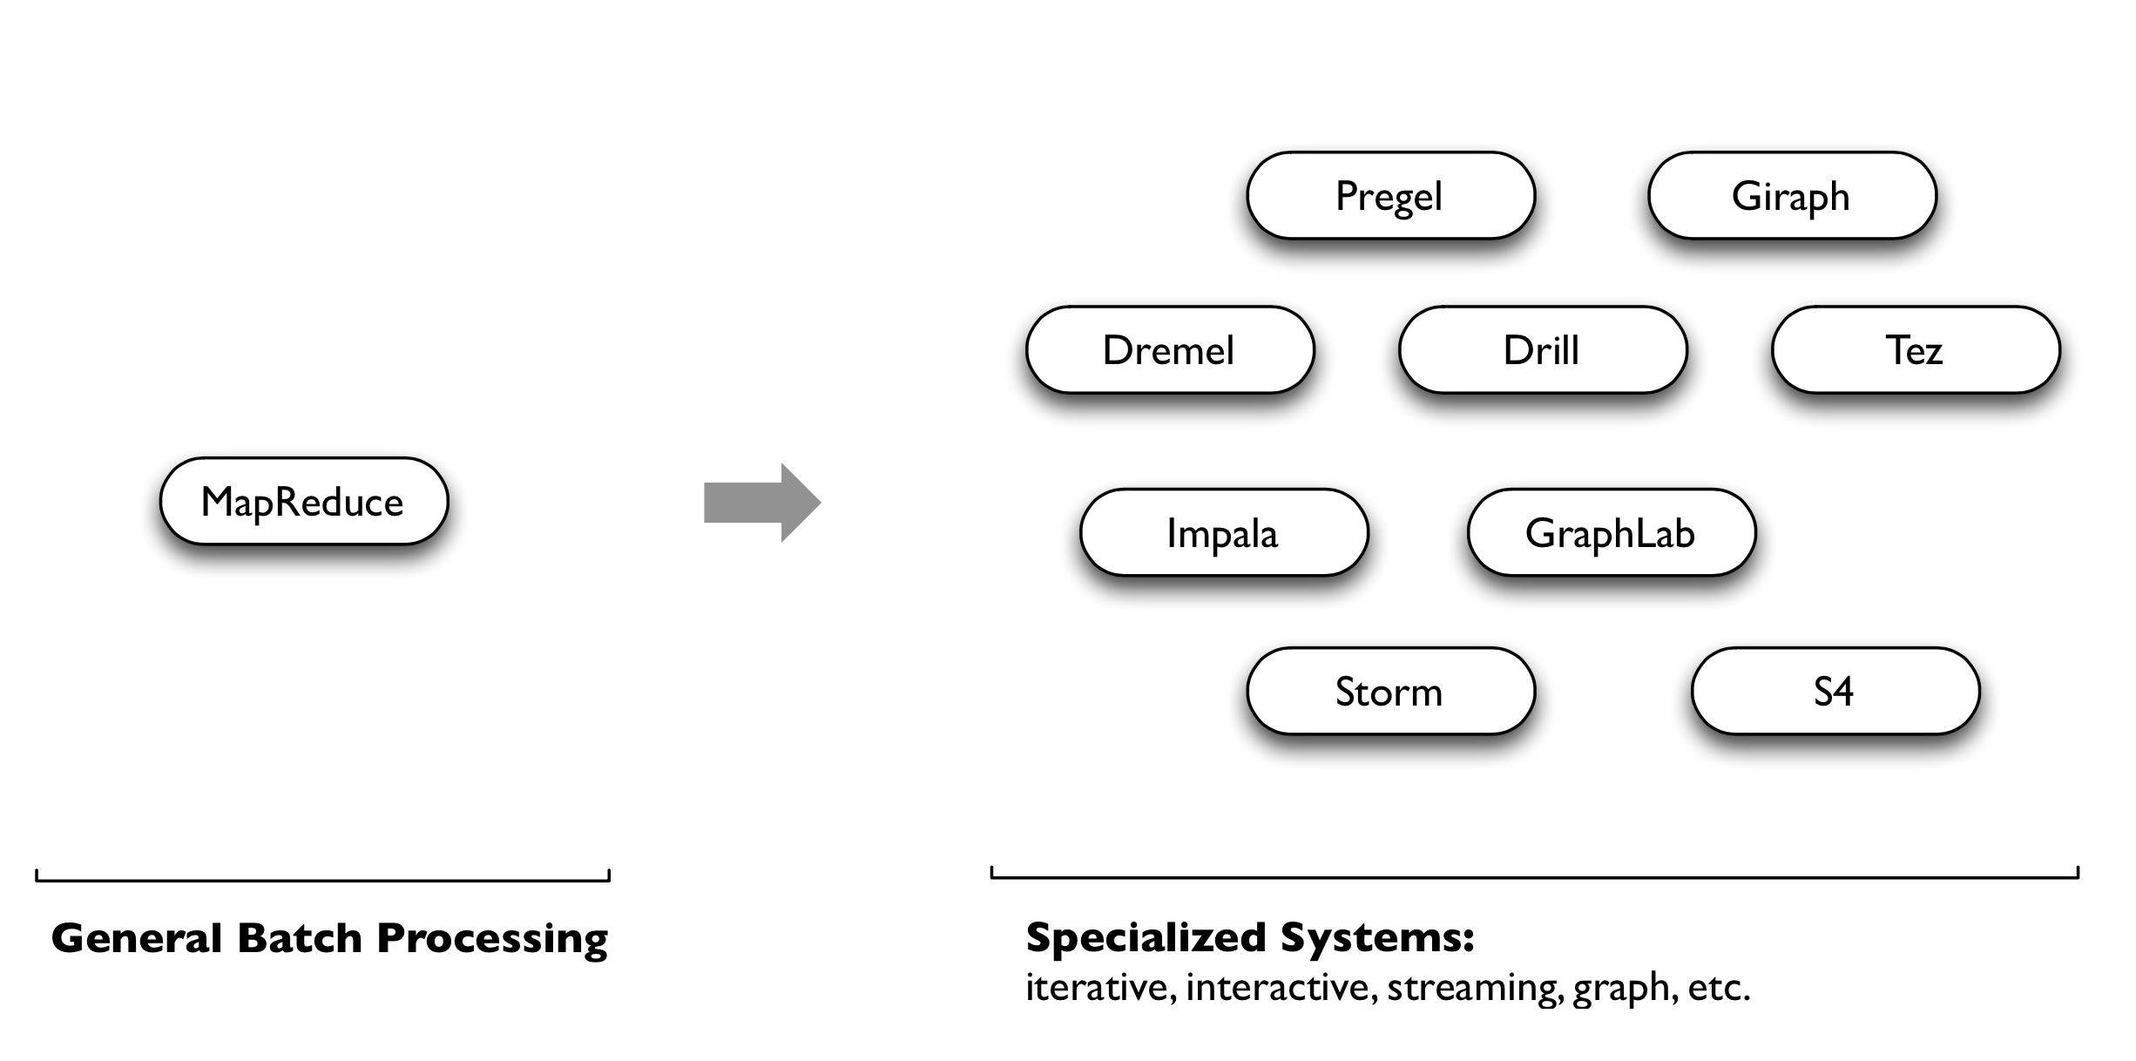
Initial Workaround: Specialization

Slide 6
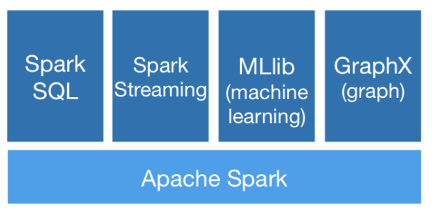
Along Came Spark
Spark’s goal was to generalize MapReduce to support new applications within the same engine
Two additions:
Fast data sharing
General DAGs (directed acyclic graphs)
Best of both worlds: easy to program & more efficient engine in general

Slide 7
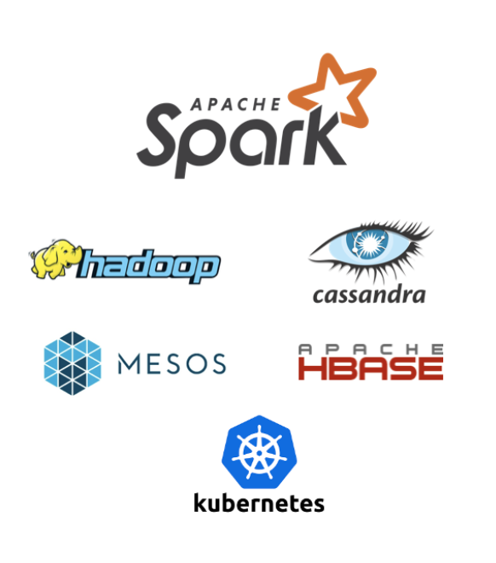
More on Spark
More general
Supports map/reduce paradigm
Supports vertex-based paradigm
Supports streaming algorithms
General compute engine (DAG)
More API hooks
Scala, Java, Python, R
More interfaces

Slide 8
Spark APIs
Two main APIs: DataSets and DataFrames
Both DataSets and DataFrames are high-level abstractions on RDDs, or Resilient Distributed Datasets
You can directly operate on RDDs if you want
(in fact, this was the default behavior until Spark 2.x)
DataSets
Benefits of RDDs (next slide) + benefits of SparkSQL’s execution engine
Not available in Python or R (wtf m8)
DataFrames
Just a DataSet, but with named columns
Conceptually equivalent to a table in a database or dataframe in R/Python

Slide 9
Resilient Distributed Datasets (RDDs)
Resilient Distributed Datasets (RDDs) are primary data abstraction in Spark
Fault-tolerant
Strongly-typed (within the JVM)
Immutable
Can be operated on in parallel
Parallelized Collections
Hadoop datasets
Two types of RDD operations
Transformations (lazy)
Actions (immediate)

Slide 10
Resilient Distributed Datasets (RDDs)
Can create RDDs from any file stored in HDFS
Local filesystem
Amazon S3
Hbase
GCP Storage
Text files, SequenceFiles, or any other Hadoop InputFormat
Any directory or glob
/data/201414*

Slide 11
Resilient Distributed Datasets (RDDs)
Transformations
Create a new RDD from an existing one
Lazily evaluated: results are not immediately computed
Pipeline of subsequent transformations can be optimized
Lost data partitions can be recovered

Slide 12
Resilient Distributed Datasets (RDDs)
Actions
Create a new RDD from an existing one
Eagerly evaluated: results are immediately computed
Applies previous transformations
(cache results?)

Slide 13
Resilient Distributed Datasets (RDDs)
Spark can persist / cache an RDD in memory across operations
Each slice is persisted in memory and reused in subsequent actions involving that RDD
Cache provides fault-tolerance: if partition is lost, it will be recomputed using transformations that created it

Slide 14
Introduction / Demo

Slide 15
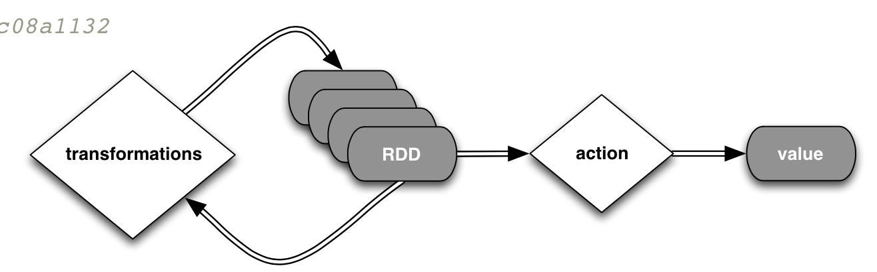
Spark Operations

Slide 16
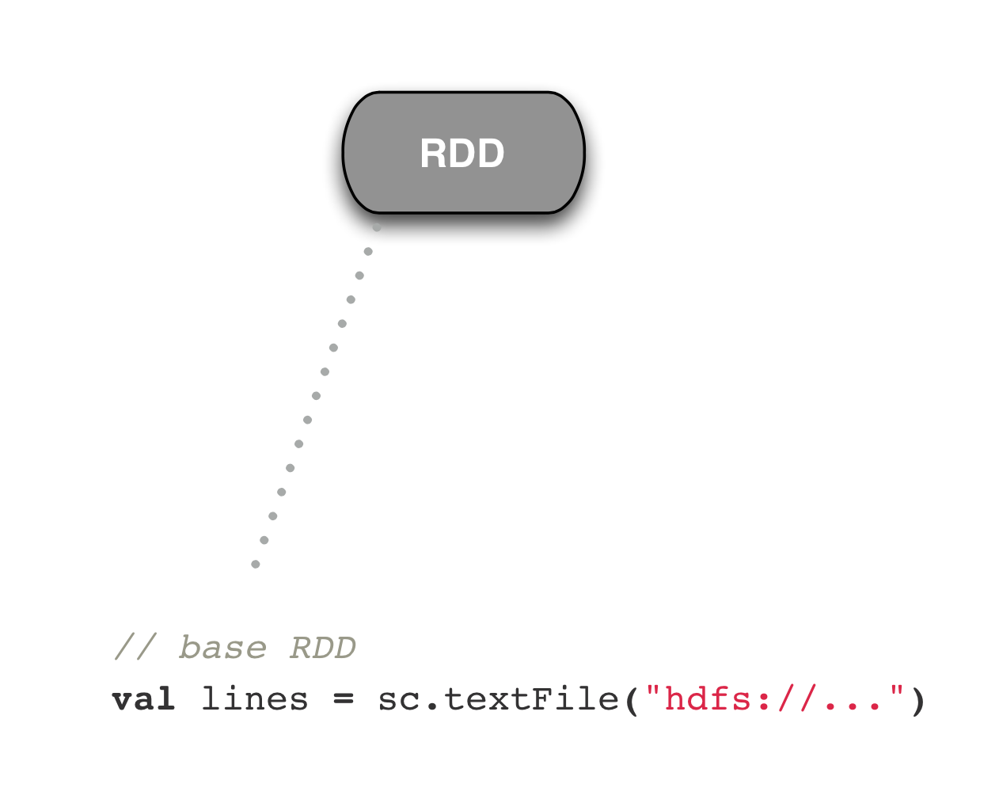
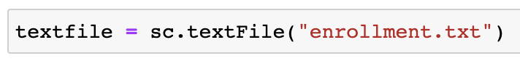
Step by step

Slide 17
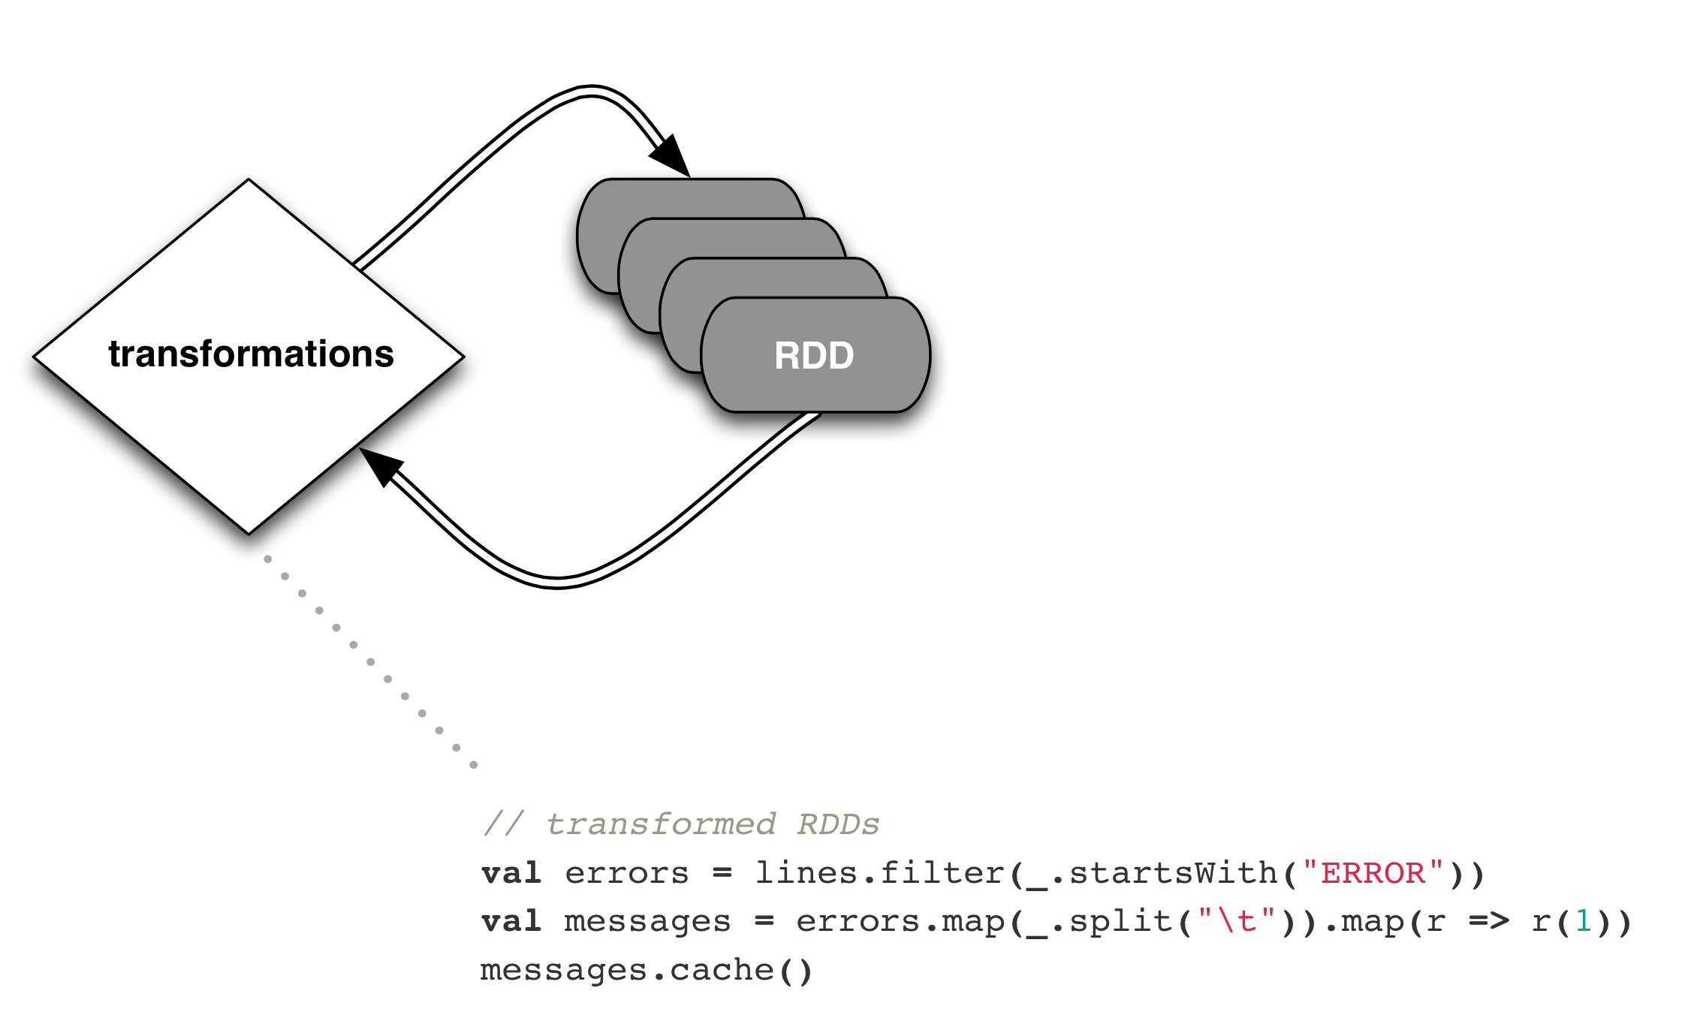
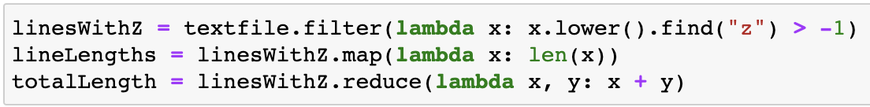
Step by step

Slide 18
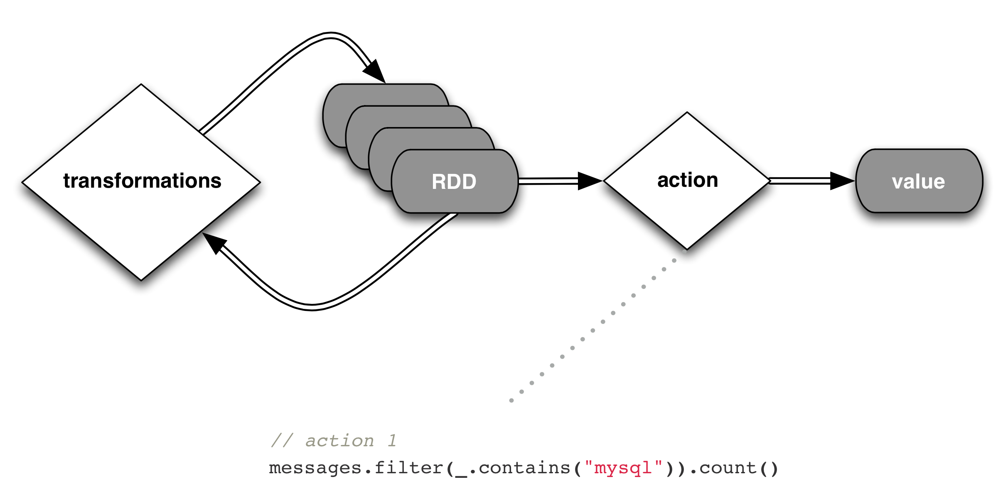
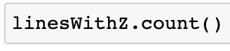
Step by step

Slide 19
API Hooks
Scala / Java
All Java libraries
*.jar
http://www.scala-lang.org
Python
Anaconda: https://www.anaconda.com/download/
…R?
If you really want to
http://spark.apache.org/docs/latest/sparkr.html

Slide 20
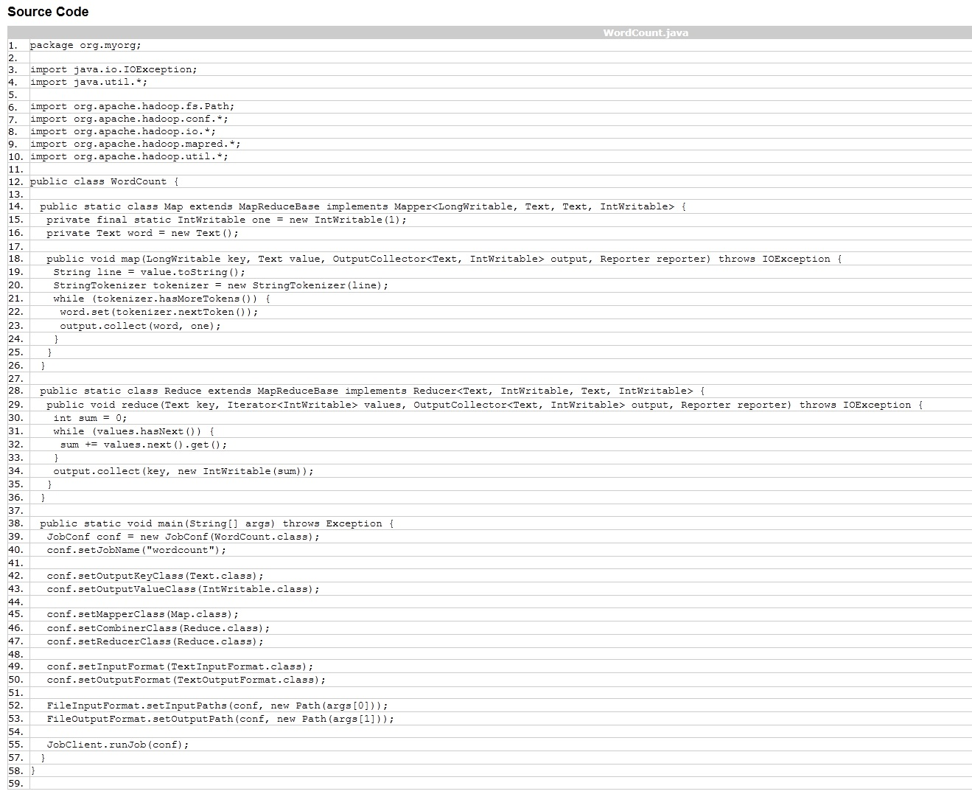
Example: WordCount

Slide 21
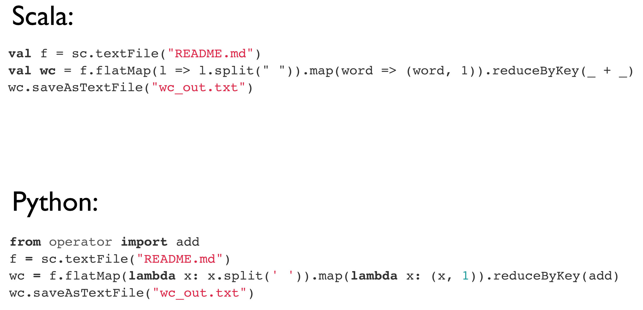
Example: WordCount

Slide 22
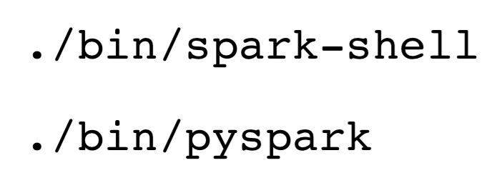
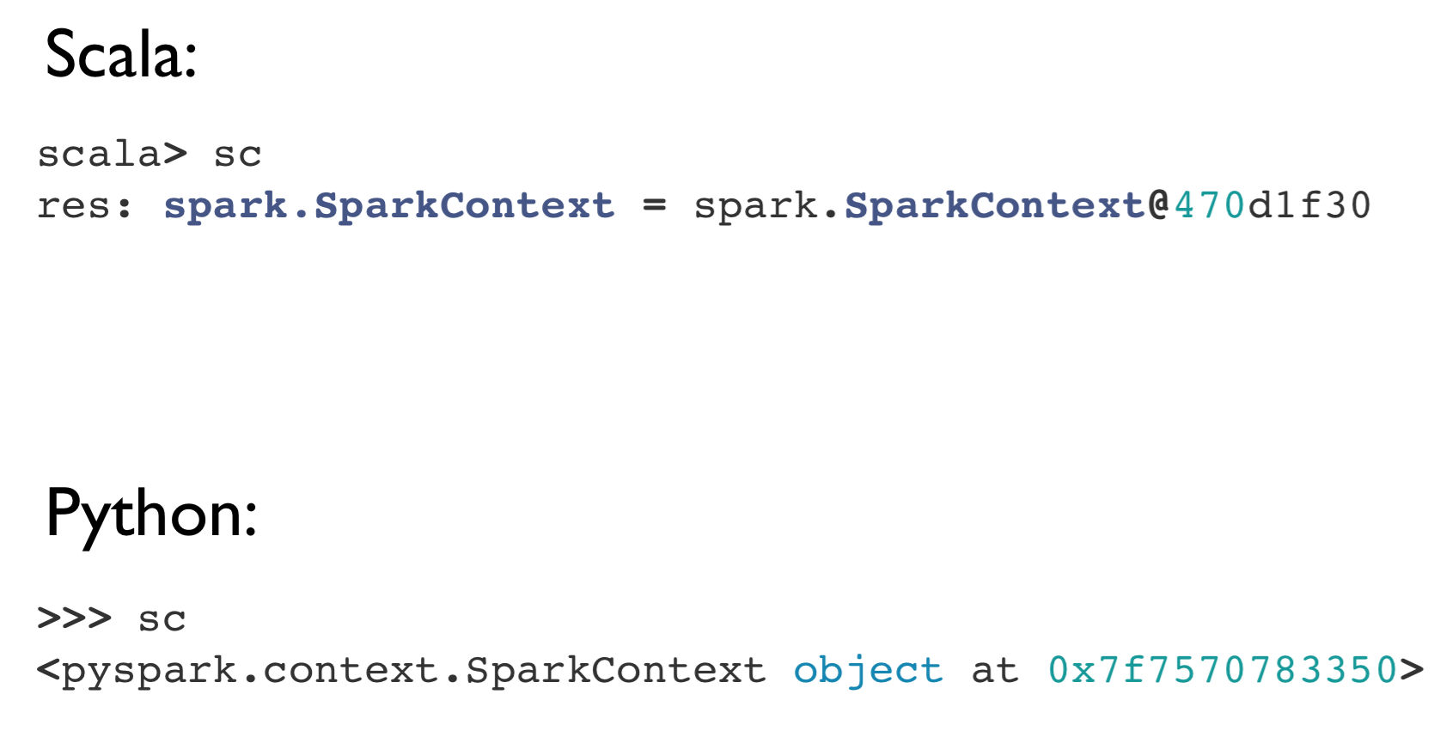
Interactive Shells
Spark creates a SparkSession object (cluster information)
For either shell: spark
External programs use a static constructor to instantiate the context
Pull the SparkContext out via spark.SparkContext

Slide 23
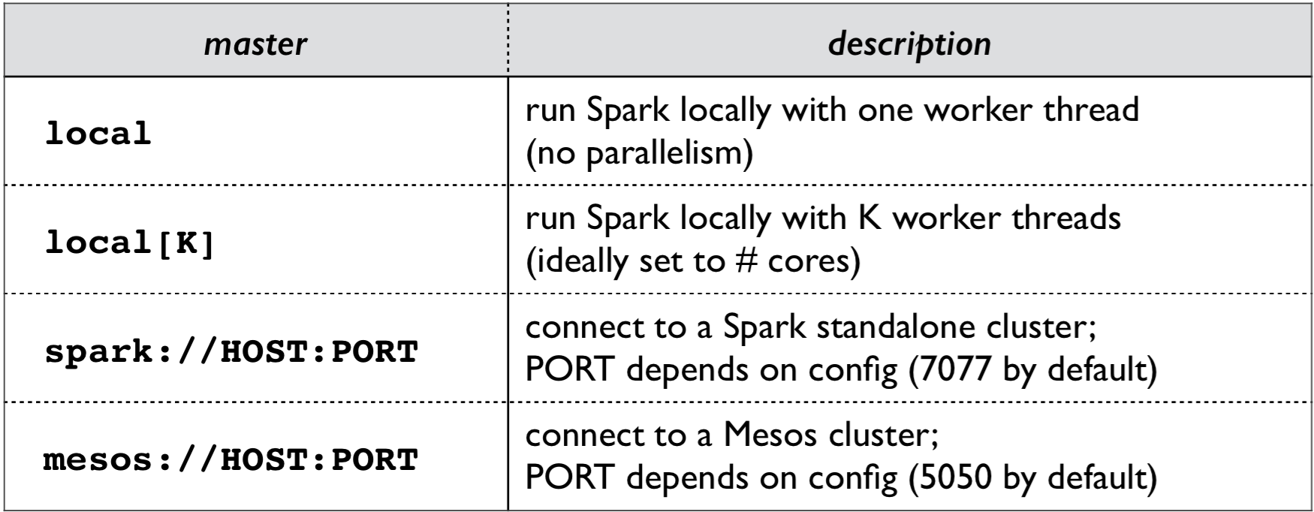
Interactive Shells
spark-shell --master

Slide 24
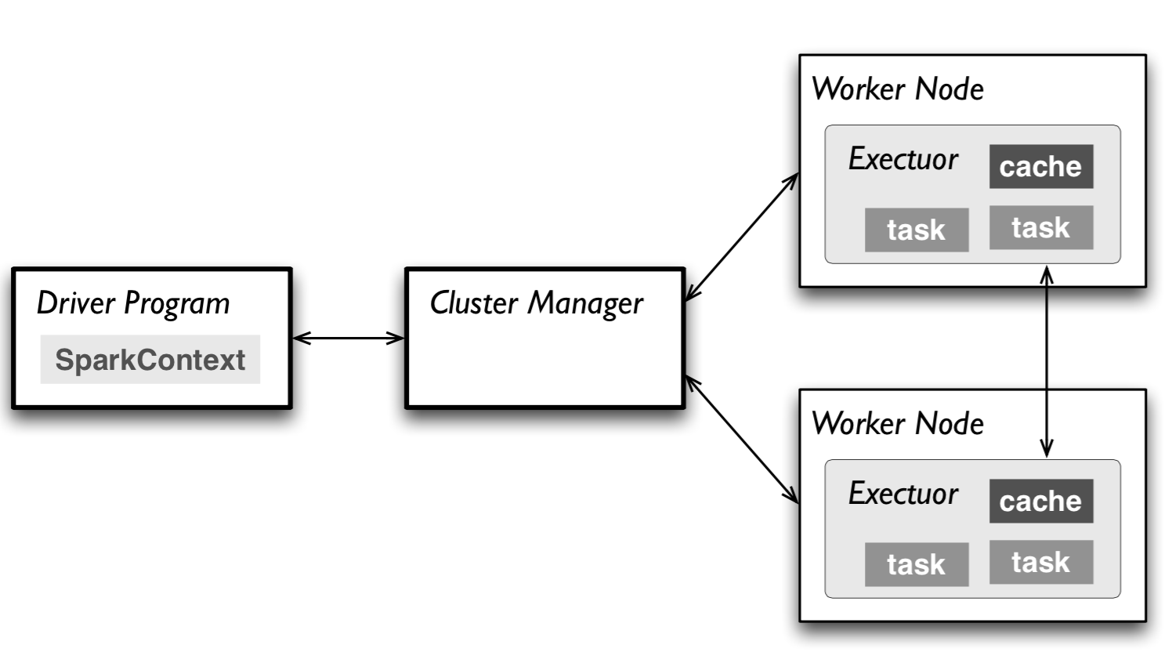
Interactive Shells
Master connects to the cluster manager, which allocates resources across applications
Acquires executors on cluster nodes: worker processes to run computations and store data
Sends app code to executors
Sends tasks for executors to run

Slide 25
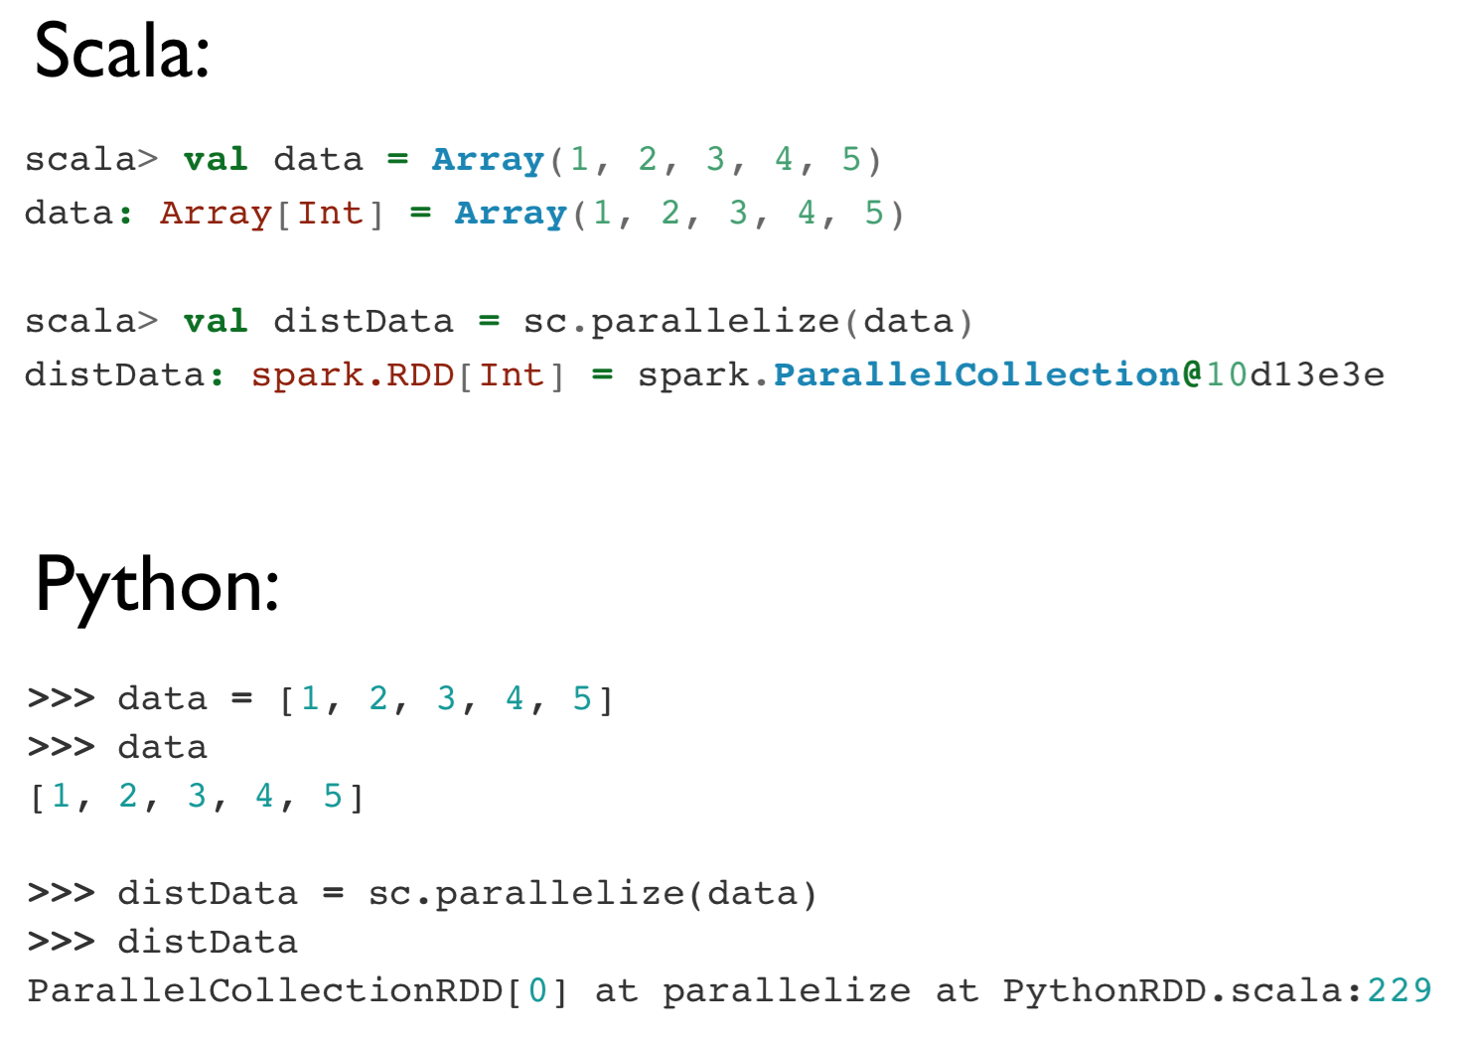
Resilient Distributed Datasets (RDDs)

Slide 26
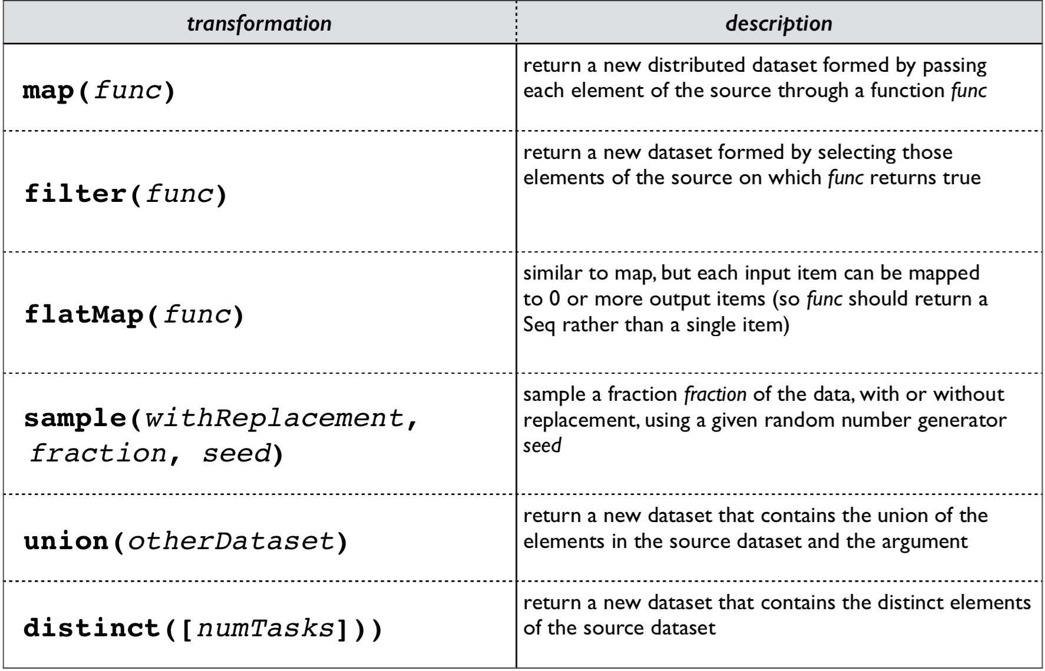
Resilient Distributed Datasets (RDDs)

Slide 27
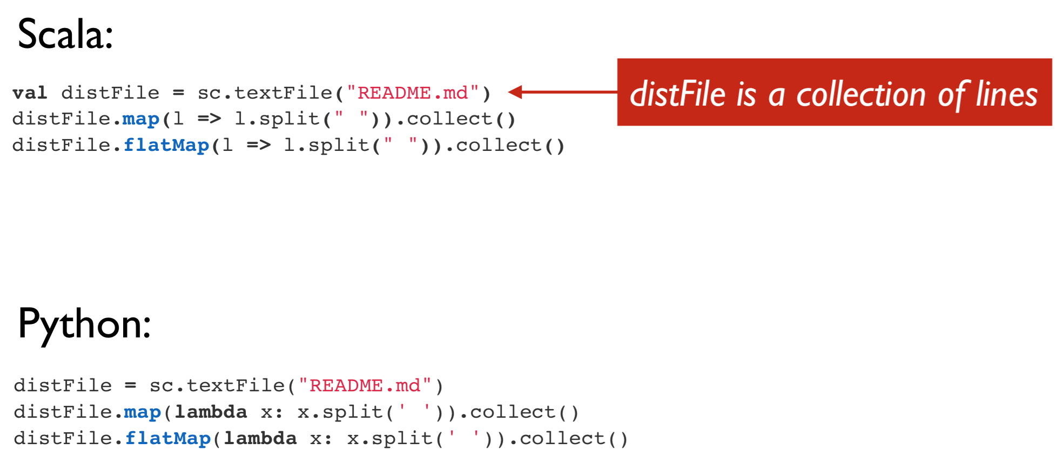
Resilient Distributed Datasets (RDDs)

Slide 28
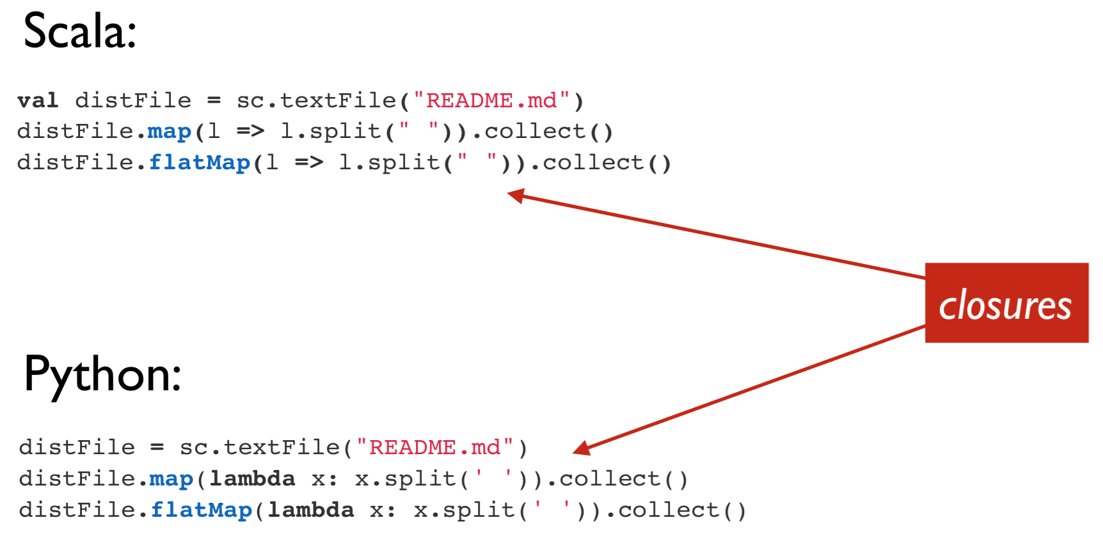
Resilient Distributed Datasets (RDDs)

Slide 29
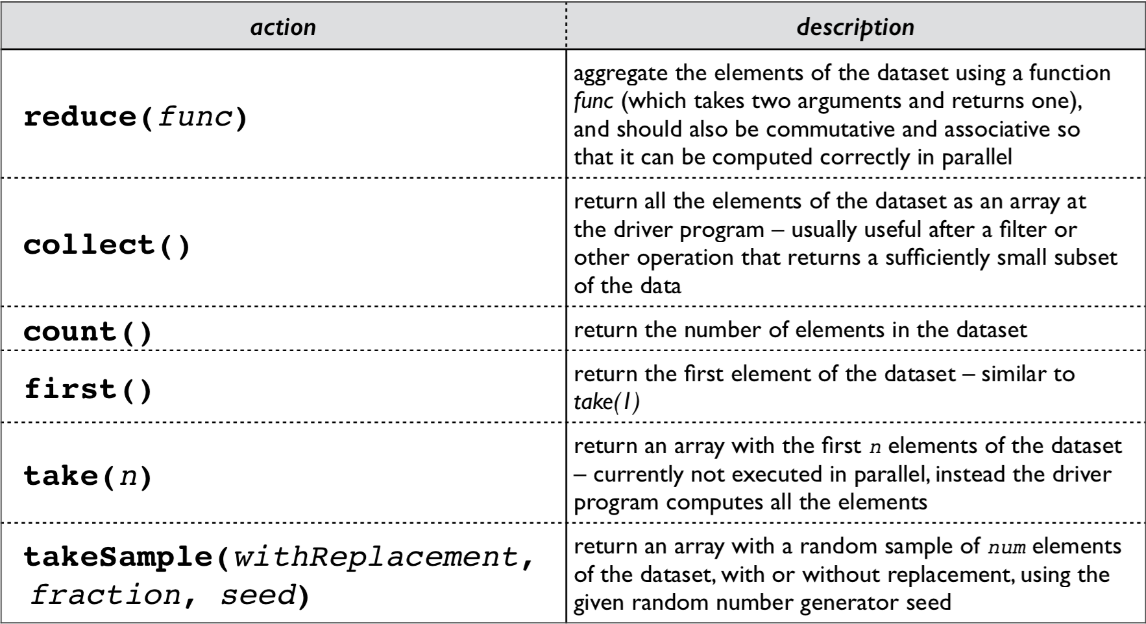
Resilient Distributed Datasets (RDDs)

Slide 30
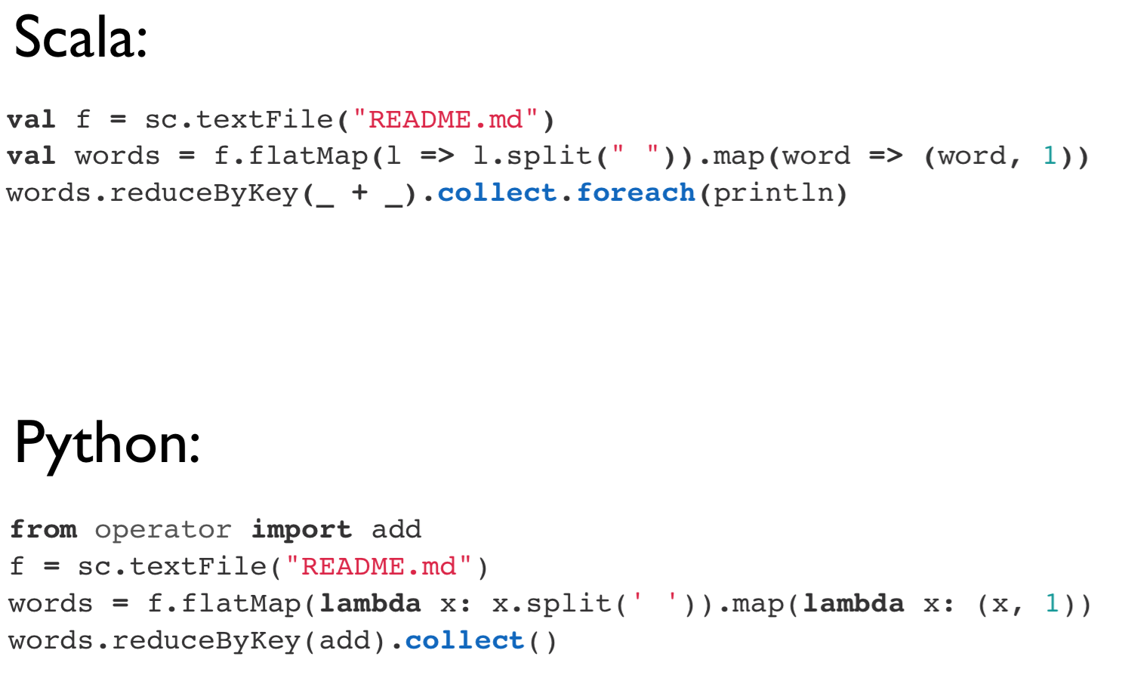
Resilient Distributed Datasets (RDDs)

Slide 31
Broadcast Variables
Spark’s version of Hadoop’s DistributedCache
Read-only variable cached on each node
Spark [internally] distributed broadcast variables in such a way to minimize communication cost

Slide 32
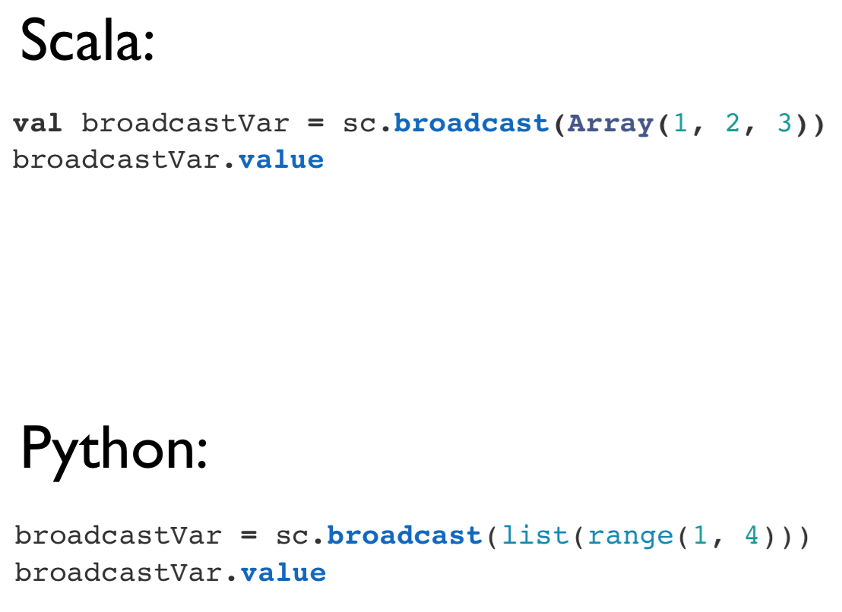
Broadcast Variables

Slide 33
Accumulators
Spark’s version of Hadoop’s Counter
Variables that can only be added through an associative operation
Native support of numeric accumulator types and standard mutable collections
Users can extend to new types
Only driver program can read accumulator value

Slide 34
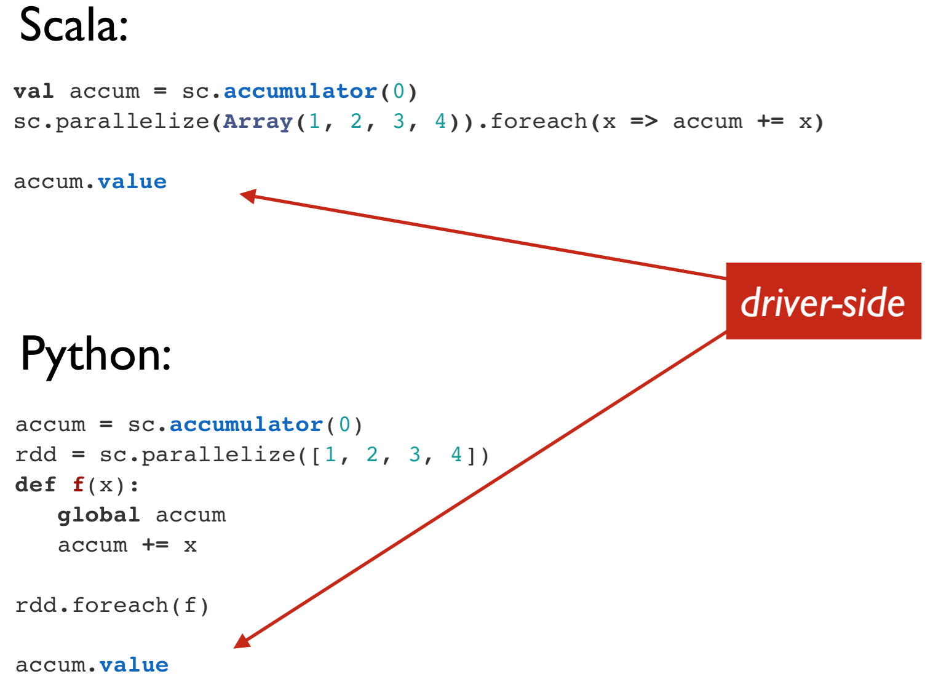
Accumulators

Slide 35
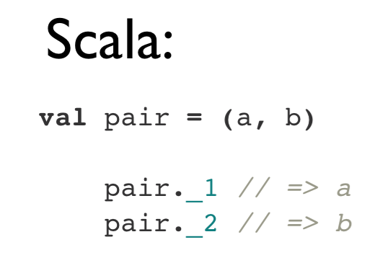
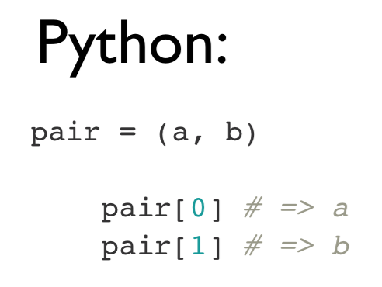
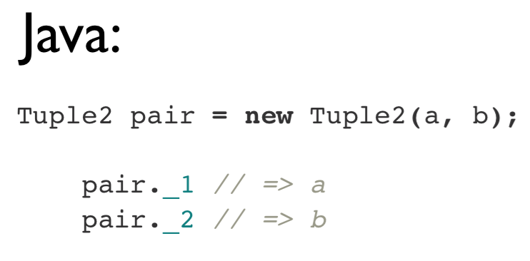
Key/Value Pairs

Slide 36
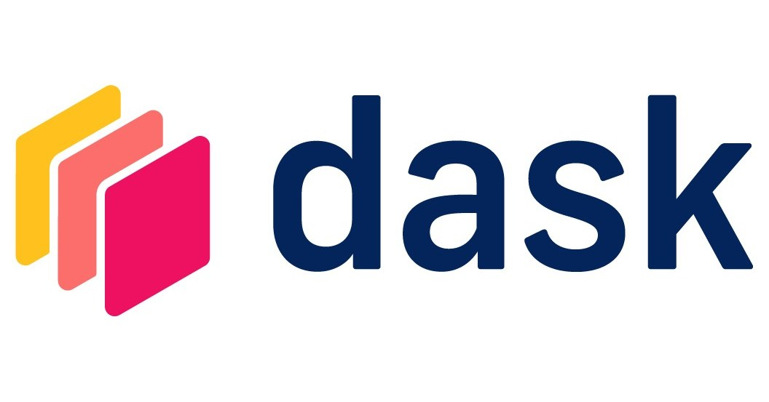
Dask

Slide 37
Dask
Exclusive to the Python ecosystem (sorry JVM / R folks)
First released in 2018
Tight integration with the SciPy ecosystem
NumPy
pandas
scikit-learn
matplotlib / bokeh
RAPIDS (more recently)

Slide 38
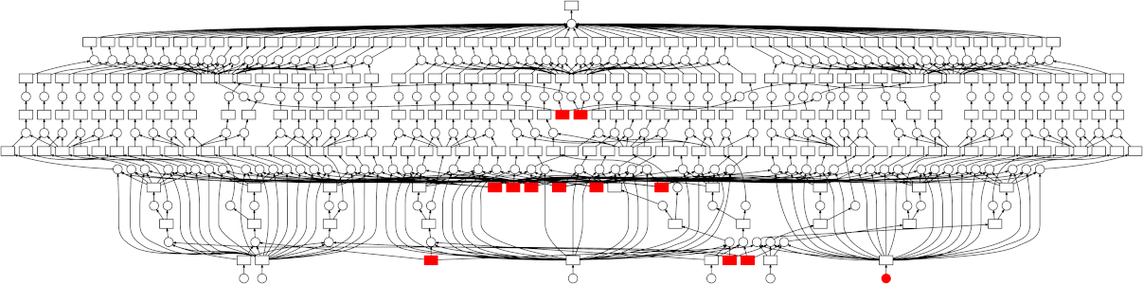
Dask
Philosophy: parallel computing with minimal fanfare
Distributed computing is almost an accidental byproduct
Uses a sophisticated but lightweight task scheduler
Builds a dependency graph of tasks (kind of like a compiler)

Slide 39
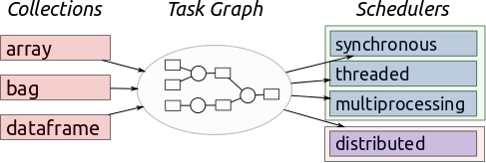
Task Scheduler
Dask has three primary data structures:
Array (modeled after NumPy)
DataFrame (modeled after pandas)
Bag (modeled after lists)
Uses delayed and futures to perform lazy evaluation while building a dependency graph of tasks
The scheduler then executes the task graph—in sequence, multithreaded, multiprocessed, or distributed.

Slide 40
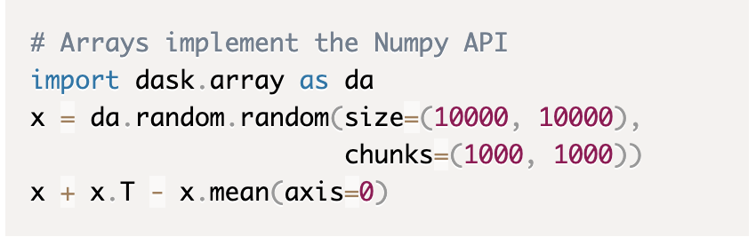
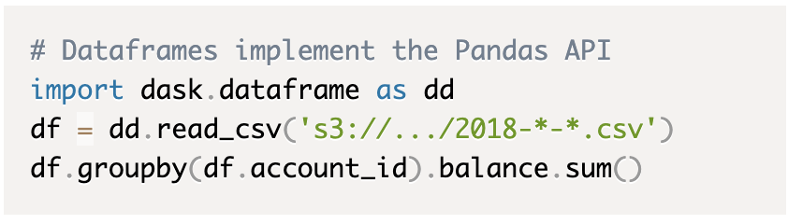
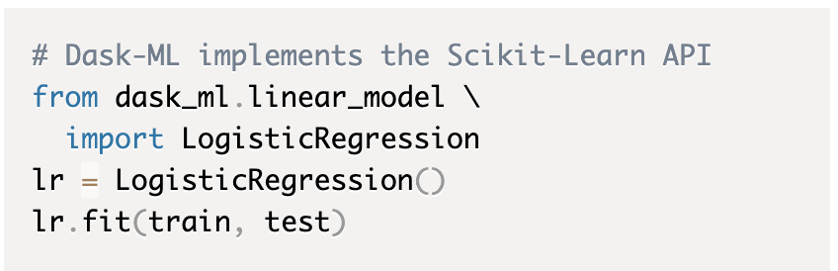
Dask APIs
Major, major effort to make APIs as seamless as possible
Array follows NumPy
DataFrame follows pandas
Bag follows map/filter/groupby/reduce common in Spark and Python lists
Dask-ML follows scikit-learn
Delayed wraps generic Python code
Futures follow concurrent.futures from standard library

Slide 41
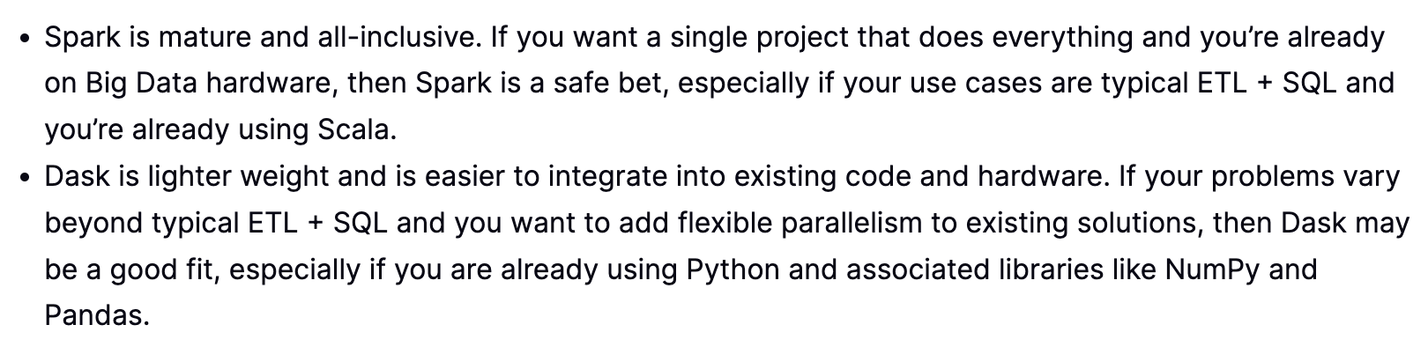
Comparisons to Spark
Entire write-up on the Dask website
https://docs.dask.org/en/latest/spark.html

Slide 42
Want to learn more?
The documentation on the dask website is second to none
https://docs.dask.org/

Slide 43
Fun Fact
Both Spark and Dask have pre-built VMs available on Google Cloud, and lots of integrations between them
Apache Spark on GCP https://cloud.google.com/learn/what-is-apache-spark
Dataproc Serverless Spark: https://cloud.google.com/dataproc-serverless/docs/quickstarts/spark-batch
Dataproc Dask cluster https://cloud.google.com/blog/products/data-analytics/improve-data-science-experience-using-scalable-python-data-processing
Dask’s cloudprovider API for Google https://cloudprovider.dask.org/en/latest/gcp.html

Slide 44

Questions?

